Slide 1
Robert’s Rules of Order
NSDC NAACP Youth Council
May 18, 2019
Presented by:
Gerald Hampton

Slide 2
Overview
What is Parliamentary Procedure?
Benefits
The Basic Principles
Who Uses These Rules?
Why Robert’s Rules…Rules!
History of Robert’s Rules
Robert’s Rules Official Books
What is a Quorum?
How to Act at a Meeting
Agenda
Standard Order of Business
All About Motions
8 Steps in Processing a Motion
Types of Motions
Frequently Used Motions
Getting Your Point Across
Asking Questions
Roll Call Voting
Voting by Unanimous Consent
For More Information
Questions

Slide 3
What is Parliamentary Procedure?
The formal procedures used by a deliberative assembly to present and discuss possible courses of action, make decisions and keep order
The rules of democracy - the commonly accepted way in which a group of people come together to conduct their business

Slide 4
Benefits
Enhanced leadership credibility
Faster and more efficient meetings
Prevention of illegal actions
Improved communication skills

Slide 5
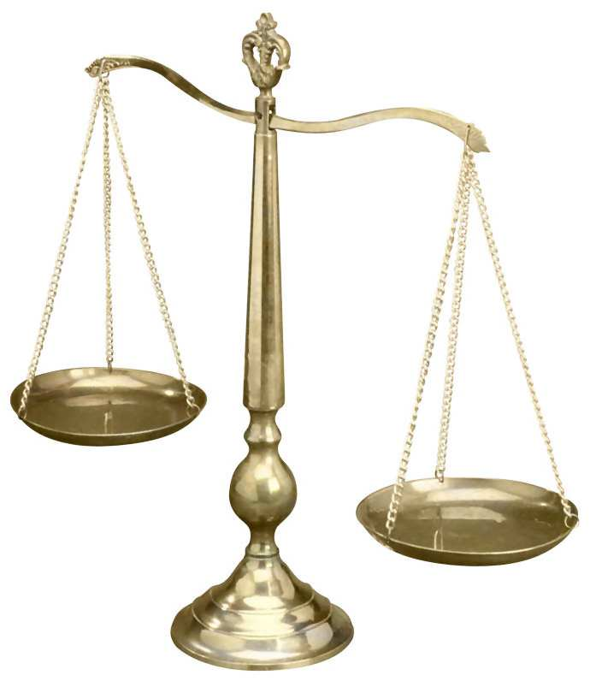
The Basic Principles
Courtesy and justice for all
Consideration of only one subject at a time
Rights of absent members must be protected
The minority must be heard
The will of the majority must prevail

Slide 6
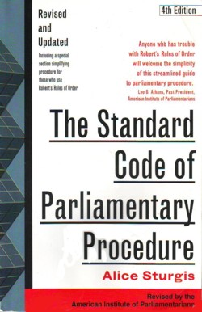
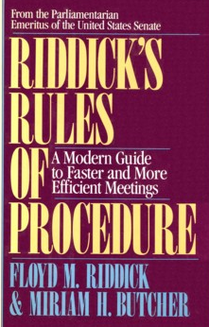
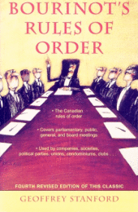
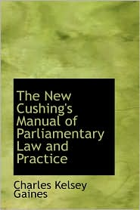
Who Uses These Rules?
Congress
Student Government
City Council Meetings
Faith-Based Organizations
Corporate Boards
School Boards
Homeowners’ Associations
Professional Associations
Fraternities and Sororities
Various Clubs

Slide 7
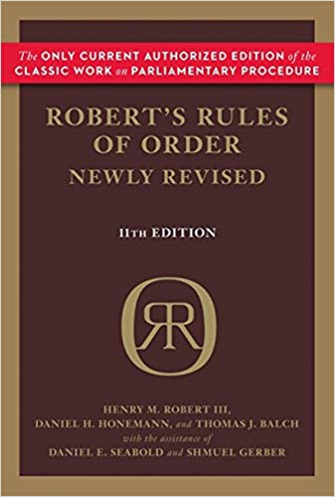
Why Robert’s Rules…Rules!
Out of all organizations that use parliamentary procedure, approximately 95% choose Robert’s Rules of Order as their parliamentary authority

Slide 8
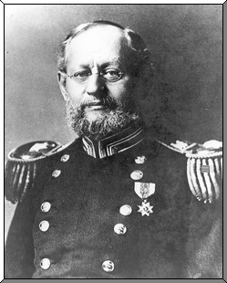
History of Robert’s Rules
Formalized by Henry M. Robert
US Army general and engineer
First edition published in 1876
The most popular authority
Over 5 million copies in print
“Where there is no law, but every man
does what is right in his own eyes,
there is the least of real liberty.”
– Henry M. Robert

Slide 9
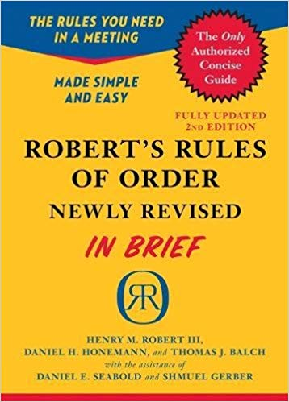
Robert’s Rules Official Books
There are only TWO official books
Current version - 11th edition, published in 2011
704 PAGES
198 PAGES
Best used for reference and technical details
Best for beginners who need only the very basics

Slide 10
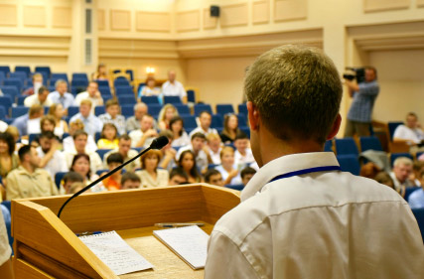
What is a Quorum?
A quorum must be present to transact business
Quorum requirement is established by the local unit per the NAACP Bylaws, which state:
“The percent of members of a Campus House of Representatives attending a meeting to establish a quorum must be 50% plus one of the membership rounded up.”

Slide 11
How to Act at a Meeting
Remain quiet while others are speaking
Address others by their title and avoid first names
If you must leave the room, request permission
If giving a speech, state your name and position
All communications in a meeting are public record

Slide 12
Agenda
An agenda sets out the business order in which specific items are to be considered
Must be approved by majority vote soon after the start of the meeting
Once approved, it is the property of the assembly

Slide 13
Standard Order of Business
Start
Call to Order
Invocation
Roll Call
Officer & Committee Reports
Tabled Business
Old Business
New Business
Announcements
Benediction
Adjournment
Finish
NSDC NAACP Youth Council Executive Committee (EC) & General Body (GB) meetings

Slide 14
All About Motions
Motion - what is it?
A formal proposal for consideration and action
Only one subject can be considered at a time
No main motion can be made while another motion is before the assembly
To make a motion say, “I move that…”
Seconding Motions
After a motion is seconded, it is stated by the chair
Doesn’t reflect “agreement”, but simply allows for discussion
Debating (Discussing) Motions
Voting
Member
Chair
Assembly

Slide 15
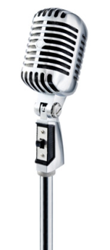
8 Steps in Processing a Motion
Step 1: Member rises and addresses the chair when nothing else is pending
Say: “Mr. / Madam Speaker”
Step 2: Chair recognizes member by nodding at the member or stating his/her name
Chair replies: “Mr. Smith”
Step 3: Member states his/her motion
Say: “I move that…”

Slide 16
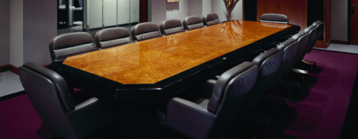
8 Steps in Processing a Motion
Step 4: Another member seconds the motion by raising a hand and calling out “Second” or “I second”.
Step 5: Chair states the motion and places it before the assembly for discussion.
“It is/has been moved and seconded that...”
“Is there any discussion?”

Slide 17
8 Steps in Processing a Motion
Step 6: Members have the right to get recognition and debate the motion. During debate, subsidiary motions (i.e. amend, refer) may be introduced to help the assembly make a final decision
Step 7: Next, the chair puts the question to a vote
“Are you ready for the question?”
“The question is on the adoption of the motion that...”
“Those in favor, say Aye or Yea.”
“Those opposed, say Nay.”

Slide 18
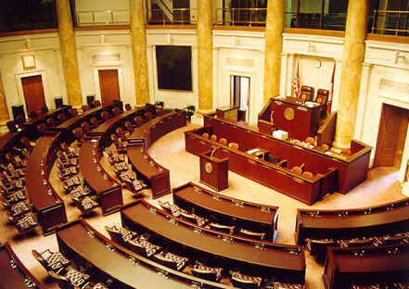
8 Steps in Processing a Motion
Step 8: Chair announces the results of the vote.
“The Aye’s [or Nay’s] has it; the motion is adopted/carried
[not adopted/failed]; we will [will not]…”
“The next order of business is…”

Slide 19
Types of Motions
Main Motion
Brings new business (or next agenda item) before the assembly
Subsidiary Motion
Changes or affects how a main motion is handled
Privileged Motion
Concerns matters of great importance or
urgency that are unrelated to pending business
Incidental Motion
Provides a means of questioning procedure concerning other motions and must be considered before the other motion

Slide 20
Frequently Used Motions
Amend
Insert, strike out, or strike out and insert words
Used to clarify or improve the wording of the original motion
Must be germane to that motion
Call for the Question
A demand to cease discussion and vote
Commit or Refer
Refers question to a specific committee
Lay on the table
Temporarily suspends further action on pending question

Slide 21
Frequently Used Motions
Limit or extend limits of debate
Modifies the rules of debate, such as length of speaking time
Postpone Indefinitely
Rejects the main motion without bringing it to a direct vote
Reconsider
Can be made only by a member of the prevailing
side who has changed position or view
Suspend the Rules
Allows for a violation of certain rules (depending on the context)
The object of the suspension must be specified

Slide 22
Getting Your Point Across
Point of Order
Brings attention to an infraction of the rules of order
Must be raised immediately after the error is made
Point of Privilege
Pertains to noise, personal comfort, etc.
May interrupt only if necessary
Usually abbreviated as “POP”
Use this to request to leave the room for any reason
Upon return, someone should motion to “Admit All Members”

Slide 23
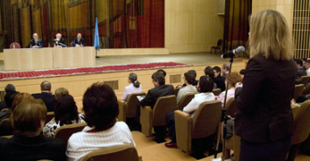
Asking Questions
Parliamentary Inquiry
A question directed to the chair to obtain information on a matter of parliamentary law or other rules.
Point of Information
A request directed to the chair, or through the chair to another person, for information relevant to the business at hand.
Usually abbreviated as “POI”

Slide 24
Roll Call Voting
Most votes are done by taking roll
Three responses in which a member may vote:
“For” (In favor of the motion or legislation)
“Against” (Opposed to the motion or legislation)
“Abstain” (Neither for nor against)
Members may abstain only if there is a distinct conflict of interest

Slide 25
Voting by Unanimous Consent
For certain parliamentary motions, the chair may simply ask the assembly if there is any objection to taking the desired action.
If no member objects, the chair declares that the action has been agreed to.
If even one member objects, the chair must then state the question and follow the complete voting guidelines.

Slide 26
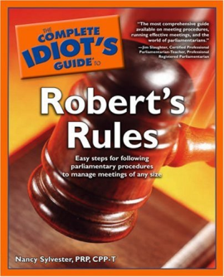
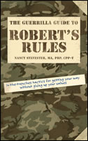
For More Information
Books
The Complete Idiot’s Guide to Robert’s Rules
The Guerrilla Guide to Robert’s Rules
Websites
RobertsRules.com
RulesOnline.com

Slide 27
Questions

